Slide 1

D-104 Gellert Rotunda
Tales from Under the Hood:
FileMaker clipboard metadata - valuable ways to use FileMaker’s private data types.
The value of ODBC - Communicating with FileMaker databases like a SQL database.
David Simpson
Notes:
Hello, my name is David Simpson with .com Solutions Inc. I have been a FileMaker developer since 1986 (39 years).
These are called private data types or clipboard data “flavors” in the OS documentation.

Slide 2
FileMaker Clipboard Data:
It started with a conversation I had with Todd Geist at DevCon.
  Did you know that FileMaker puts a lot of interesting info onto the clipboard?
This conversation started my journey into exploring FileMaker clipboard objects.
I have used the private clipboard data functionality extensively to build tables, value lists, custom functions, layouts & scripts.
Access, Visual FoxPro, SQL Server & MySQL to FileMaker
FileMaker Table Consolidation or Rebuild projects

Slide 3

FileMaker Clipboard Data:
Last year, this video from Todd showed performing script generation with Anthropic Claude models.
  Offscreen he is using some type of tool to set the clipboard.
  https://www.proofgeist.com/blog/2024/09/05/exploring-generative-ai-with-filemaker-and-having-a-blast/
  So I built a cross-platform tool (macOS/Windows) everyone can use…

Slide 4
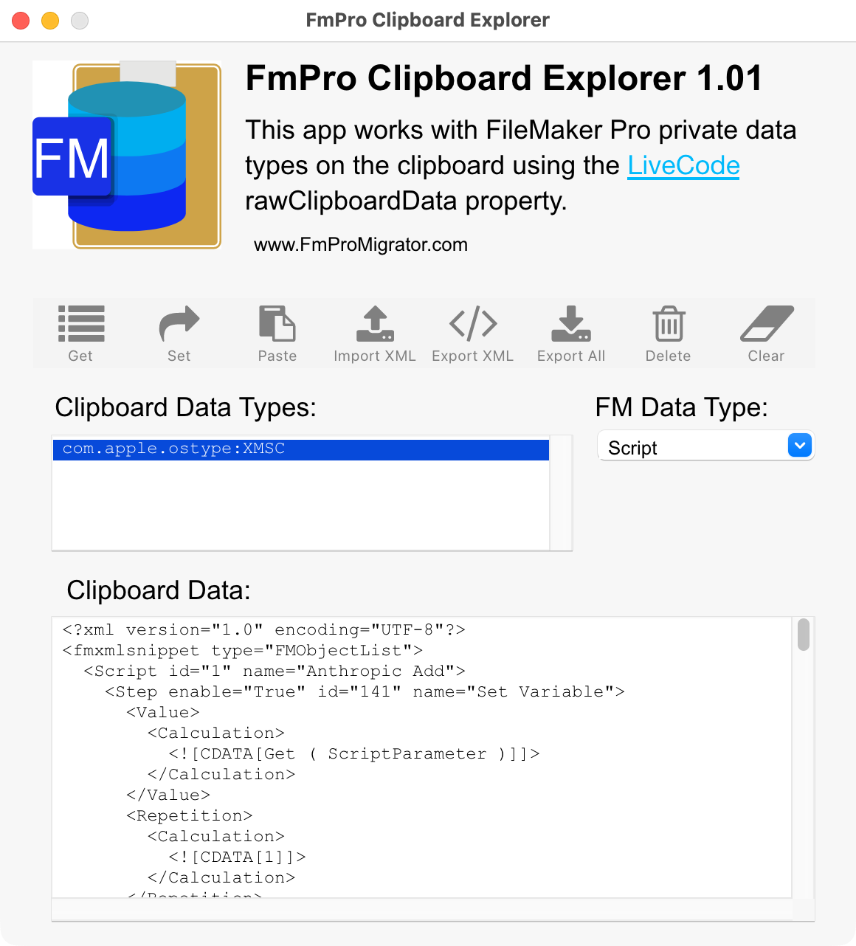
Session: FmPro Clipboard Explorer
Quick Demo:
Notes:
Here is a script I have pasted into the tool from Anthropic by clicking the Paste button while having the FM Data Type menu set = Script.

Slide 5
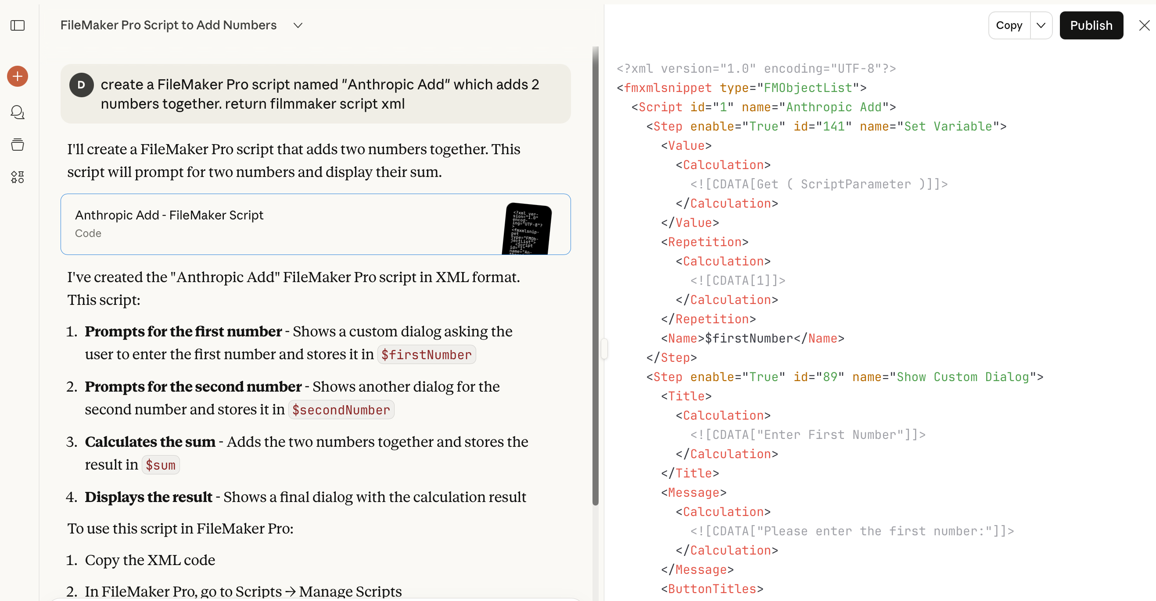
LLM Generated Script:
Copy LLM Generated XML via web or App - Paste Button or Command+V / Control+V
Set Button or Command+C / Control+C
Paste into Script Workspace within FileMaker
Notes:
One of the useful tasks you can perform with this tool is pasting LLM generated scripts directly into the Script Workspace.

Slide 6
Clipboard Wishlist:
Copying the contents of the Relationship Graph?
Is this hard for Claris to implement?
How might we use this feature?
  Rebuild an entire solution.
  Build a FileMaker solution from other databases: Access, Visual FoxPro, MySQL, SQL Server
  Build relationships much faster than using AppleScript.
  Build relationships cross-platform - not dependent upon running AppleScript on macOS.

Slide 7
Discussion

Slide 8
FileMaker ODBC/JDBC:
ODBC instead of CSV/TAB imports.
Examples:
  Access, Visual FoxPro, SQL Server & MySQL to FileMaker
    Most Access/VFP to FileMaker conversions aren’t running FileMaker Server.
  Create/Drop/Truncate Temp Tables
  Update Existing Records
    [Example: Update Container Fields]

Slide 9
FileMaker ODBC/JDBC:
  Drop Columns in FileMaker tables [Unstored Calc/Summary, Global Fields)
    Consider: Dependencies between scripts/fields/calcs.
    Programmatically cycle thru fields in both directions.
  Tools: Mirror Sync, LuminFire BrilliantSync, FmPro Migrator, Tableau Connector for FileMaker by Beezwax,

Slide 10
FileMaker ODBC/JDBC Wishlist:
Windows 11 ARM Support
  Microsoft Surface Pro, Surface Laptop Devices run Windows 11 ARM software
  Apple Silicon - Parallels runs Windows 11 ARM
    macOS 26 - Last release for x86_64
ODATA - How does performance compare with ODBC/JDBC?
  Could ODATA be used without FileMaker Server?
  Would tools like MirrorSync be able to transfer 33GB of data in 7 minutes with ODATA instead of JDBC?

Slide 11
Discussion

Slide 12
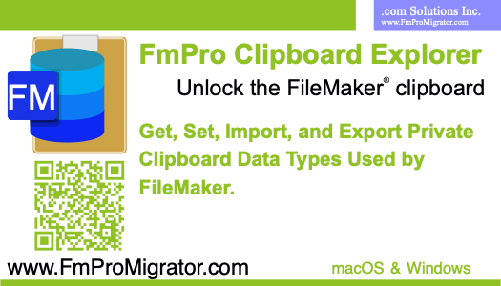
Questions?
Pick up a card with the QR code to download the FmPro Clipboard Explorer.
https://www.fmpromigrator.com/downloads/demo_software/index.html#fce
Contact Info:
David Simpson
www.FmProMigrator.com

